Slide 1
Toms River & Brick Township Joint Roadway Elevation Project Presentation
Presented to:
Residents of Normandy Beach

Slide 2
Roadway Elevation Project Presentation
Virtual Sign In:
Please Email: engineering@tomsrivertownship.com
Re: Road Elevation

Slide 3
Roadway Elevation Project Presentation
In Attendance:
Joanne Bergin – Brick Township Business Administrator
Elissa Commins, PE, CFM – Township Engineer (Brick)
Louis Amoruso, Toms River Township Business Administrator
Brian Decina, PE, CME – Vice President – FPA Engineers (Consultant)
Robert J. Chankalian, PE, CME – Township Engineer (Toms River)

Slide 4
Roadway Elevation Project Presentation
Toms River Township and Brick Township have joined together to work on a flood mitigation project for the Normandy Beach section of both Townships.
Mayor Ducey and Mayor Hill directed both Engineering Divisions to apply for NJDOT grant funding which was received last year.
The Township Councils of Brick and Toms River Township entered into an agreement for Toms River to design and oversee the project.

Slide 5
Roadway Elevation Project Presentation
Total Cost of the Project - $5 Million
Grants will offset $750,000 of the project cost.
Funding was already approved in both 2021 Capital Budgets.
Construction is anticipated to start this fall, and to be complete by Memorial Day 2023.

Slide 6
Roadway Elevation Project Presentation
Roadway elevation projects started as a pilot program conducted in Toms River Township.
The program was a result of a study that was prepared after other solutions, such a check valves, were determined to be ineffective and residents still experience flooding events.
The program initially involved four (4) of the lowest streets in the Township.
Those projects are complete and have been very successful with the adjoining residents.
Another (3) projects have since been completed as well.

Slide 7
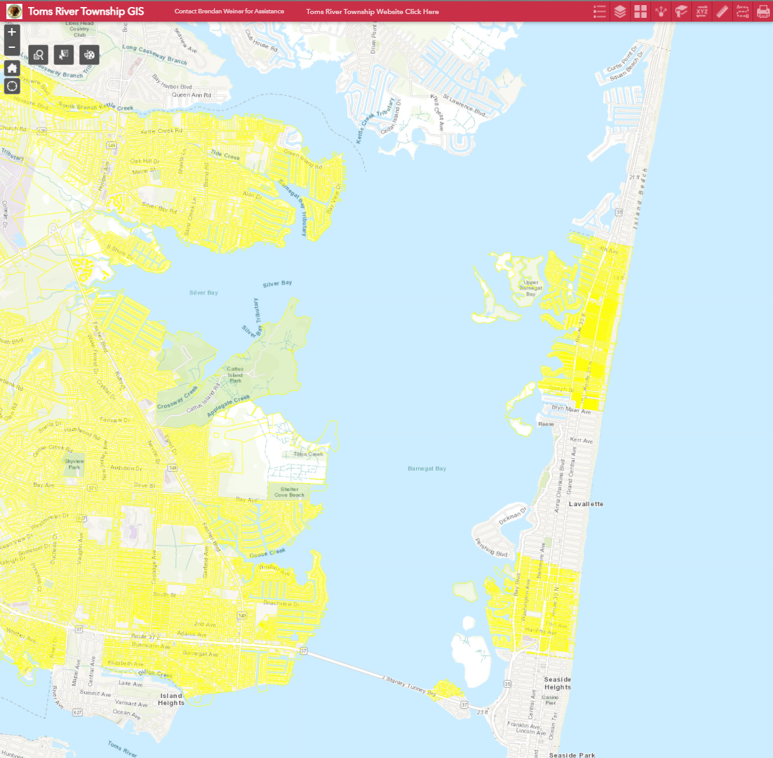
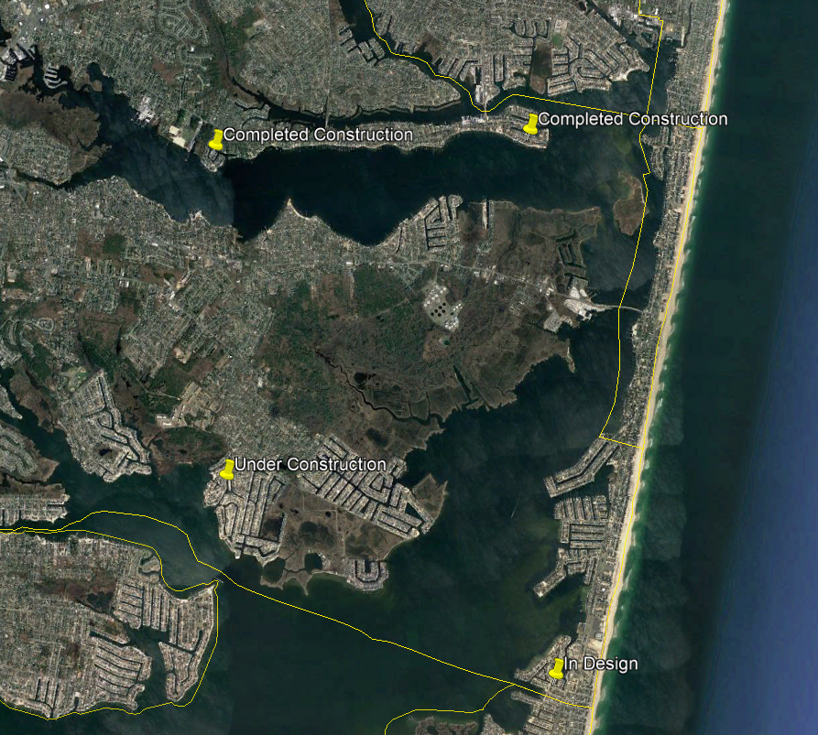
Roadway Elevation Project Presentation
Brick
COMPLETE PROJECT
UNDER CONSTRUCTION
IN DESIGN
Toms River
Completed Projects

Slide 8
Roadway Elevation Project Presentation
Project Understanding:
The purpose of this project is to minimize nuisance roadway flooding and to help maintain access to low lying properties in the floodplain.
This project will not prevent all roadway flooding; otherwise the road would have to be as high as the new FEMA Base Flood Elevations used for homes.

Slide 9
Roadway Elevation Project Presentation
Purpose of todays meeting:
To review the project and show the residents how the project will progress, what the benefits will be, and how their properties will be affected.
Keep in mind, the higher the road is raised, the more impact to the adjoining properties.

Slide 10
Roadway Elevation Project Presentation
Factors to consider….
Generally, we cannot raise the road above the level of a home or garage.
Consensus to proceed with the project, and the desired elevation, is important for the project to be effective.

Slide 11
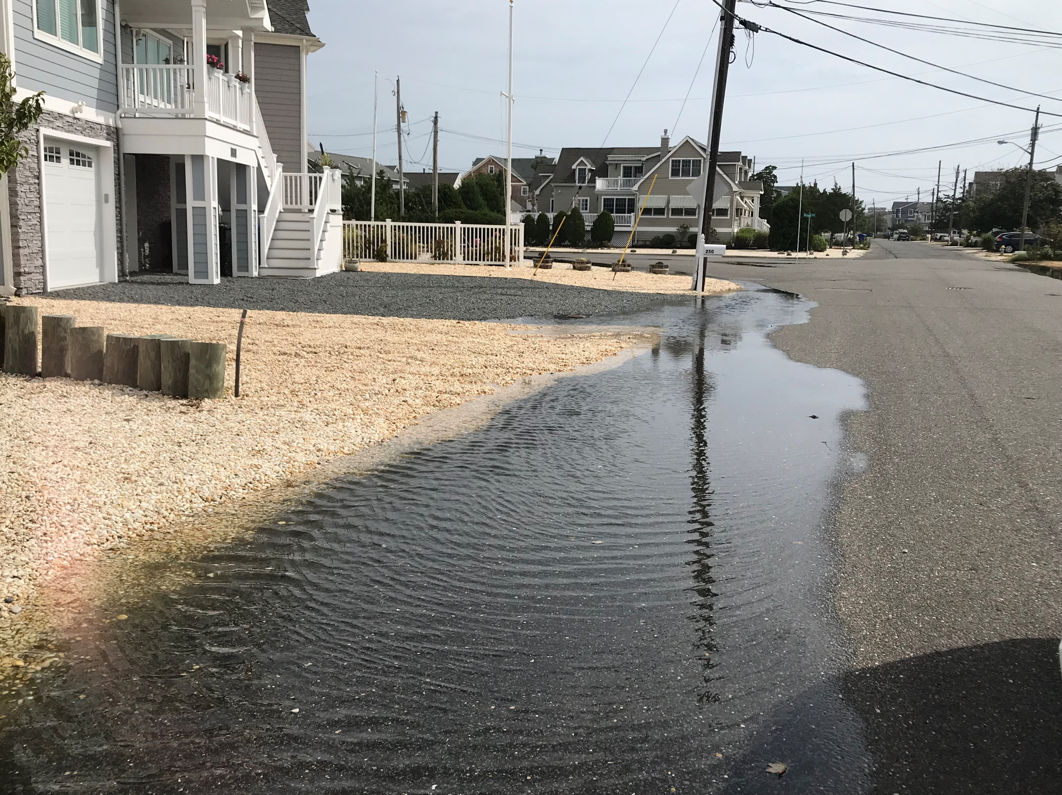
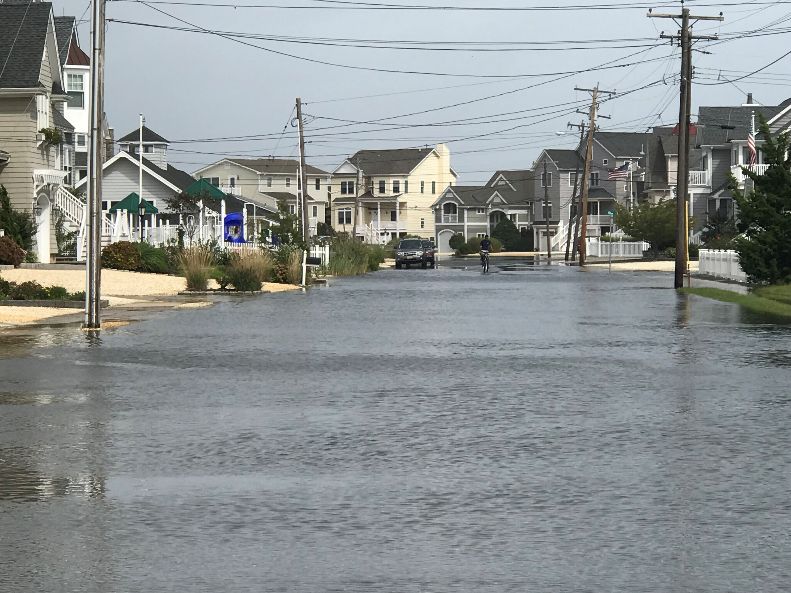
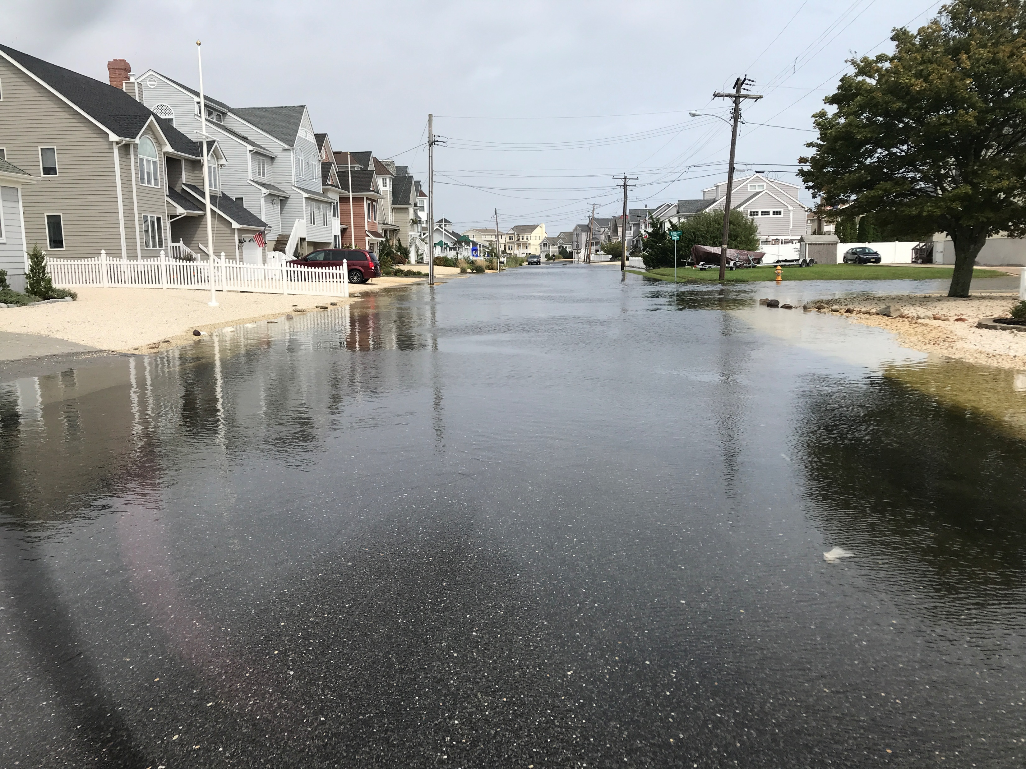
Roadway Elevation Project Presentation
Why we are here….

Slide 12
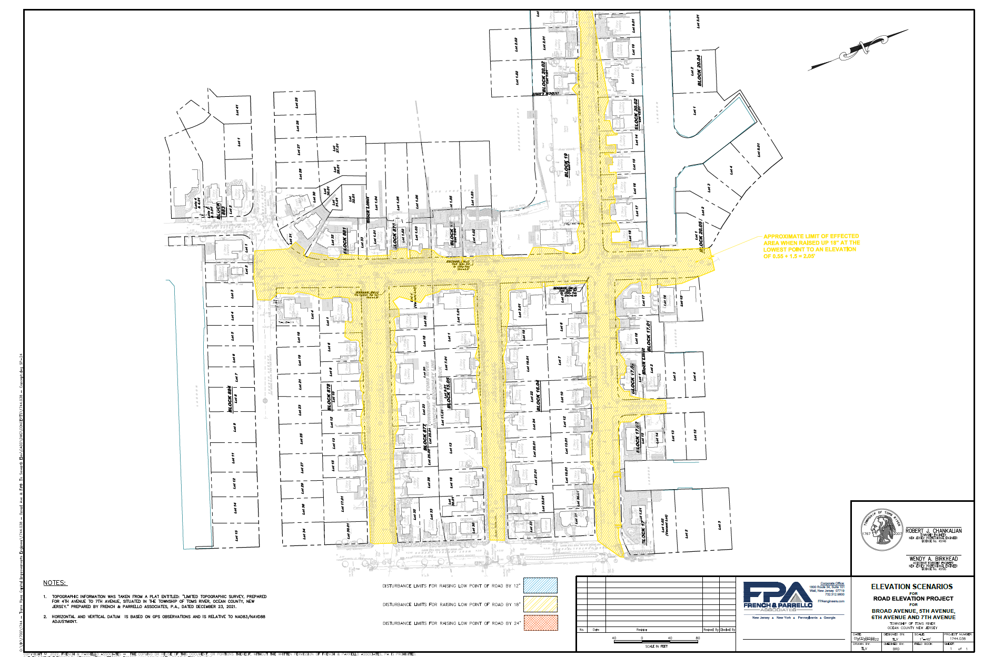
Roadway Elevation Project Presentation
Existing Lowest Catch Basin
Grate = 0.55 ASL.
After the project it will be 18” higher
Grate = 2.05’
Minimum Centerline of Roadways will be 2.55’

Slide 13
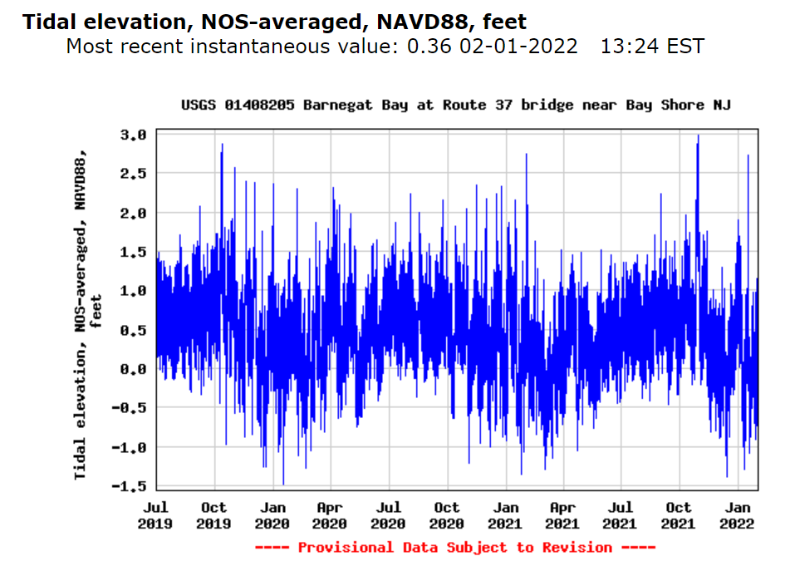
Roadway Elevation Project Presentation
Proposed Roadway Crown
or Centerline Elevation
Proposed Roadway Gutter Elevation
Current Roadway Crown
or Centerline Elevation
Current Roadway Gutter Elevation
Centerline Flooding Events
Without Project
30 (Months)
Centerline Flooding Events
With Project
30 (Months)

Slide 14
Roadway Elevation Project Presentation
What to expect…..
Typically new catch basins and curbs (if needed) at the low point of the road will be elevated to the selected height, say 12” to 18”.
Once complete, grading to the newly raised catch basins will commence, and then installation of base paving.
Yard & driveway restoration will take place as well as the final course of elevated road paving.

Slide 15
Roadway Elevation Project Presentation
Design Goal:
Minimum Gutter Elevation 2.0, with the crown at 2.5 ASL.
Past experience has shown that with recent storms, elevation 2.0 is typically above the storm surge from prolonged high tides and wind events.
Major storms will still cause flooding, but the frequency of flooding events will be less, as will the depth of flooding when these events occur.

Slide 16
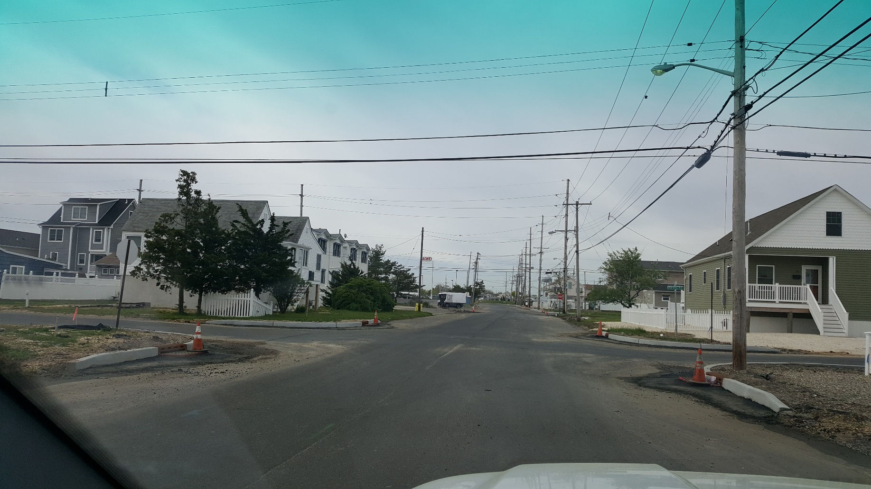
Roadway Elevation Project Presentation
What to expect…..
Note how the high the catch basins are…

Slide 17
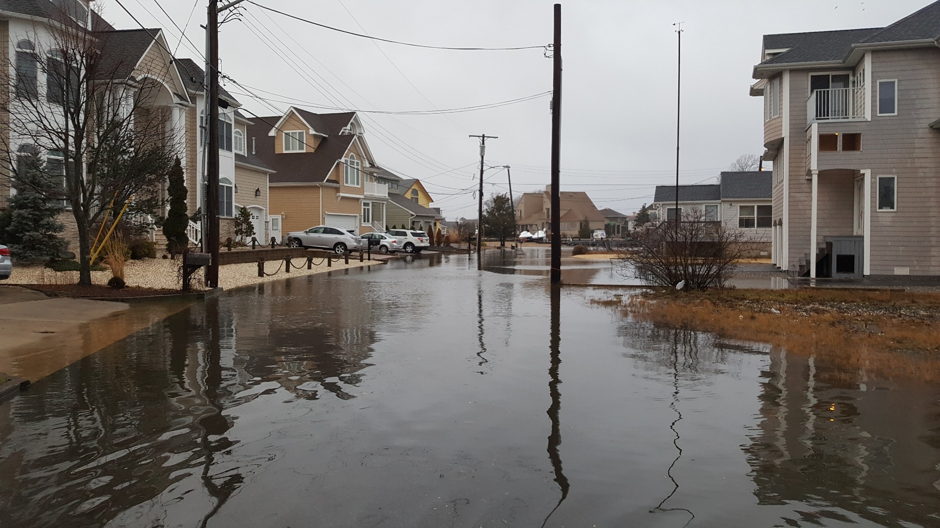
Roadway Elevation Project Presentation
Before…

Slide 18
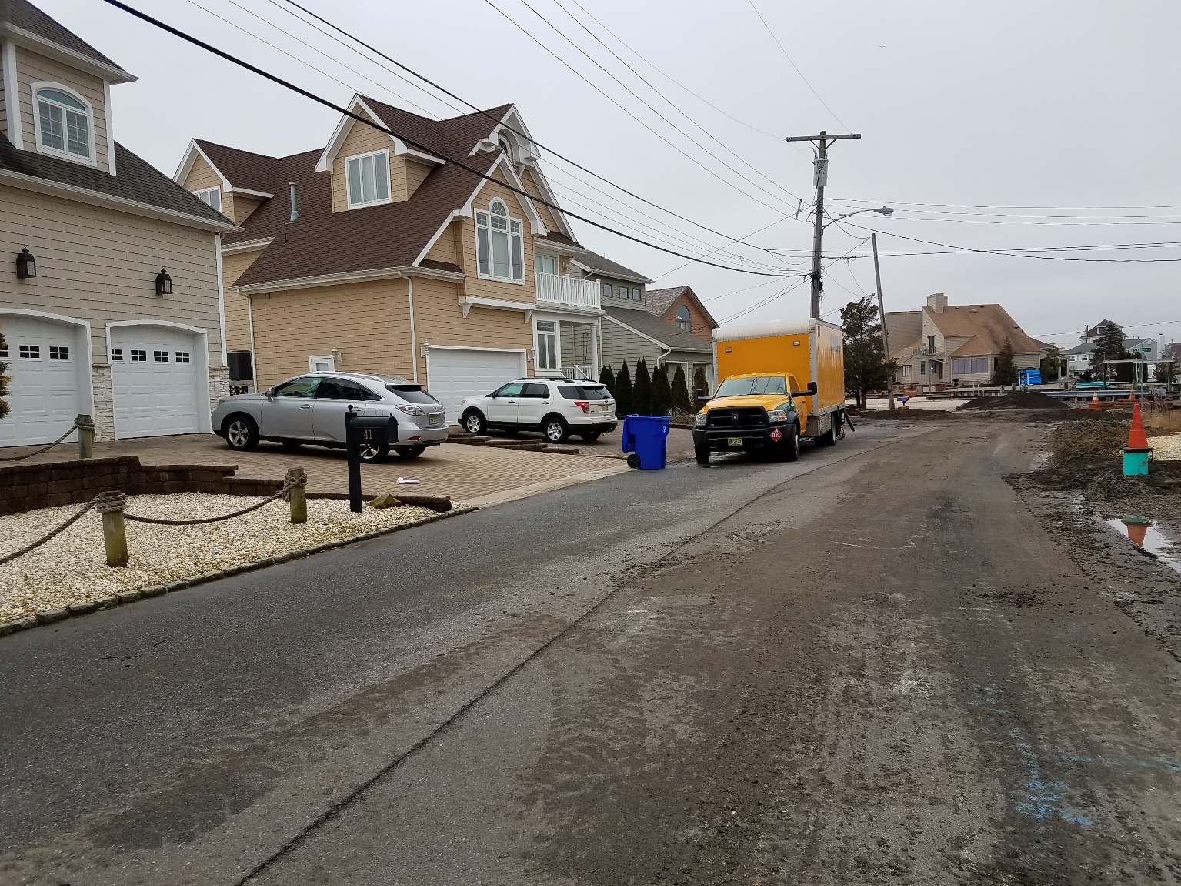
Roadway Elevation Project Presentation
After new drainage is installed…
New drainage is installed above the old roadway…..

Slide 19
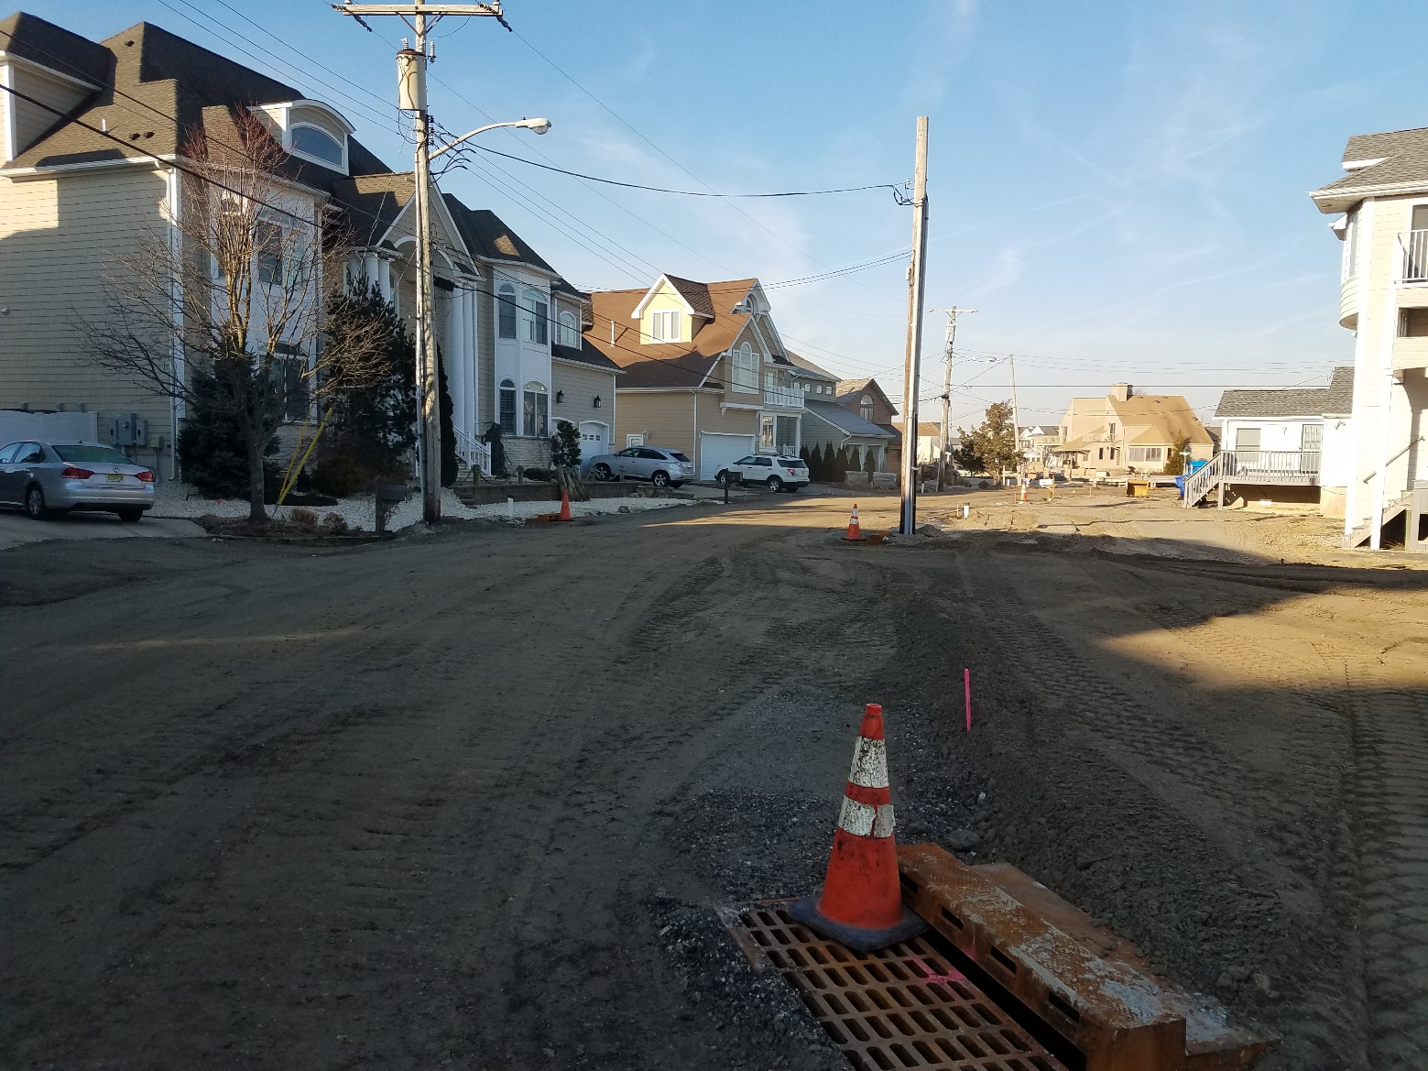
Roadway Elevation Project Presentation
After filling of the road…
The road has been filled to match the new drainage…

Slide 20
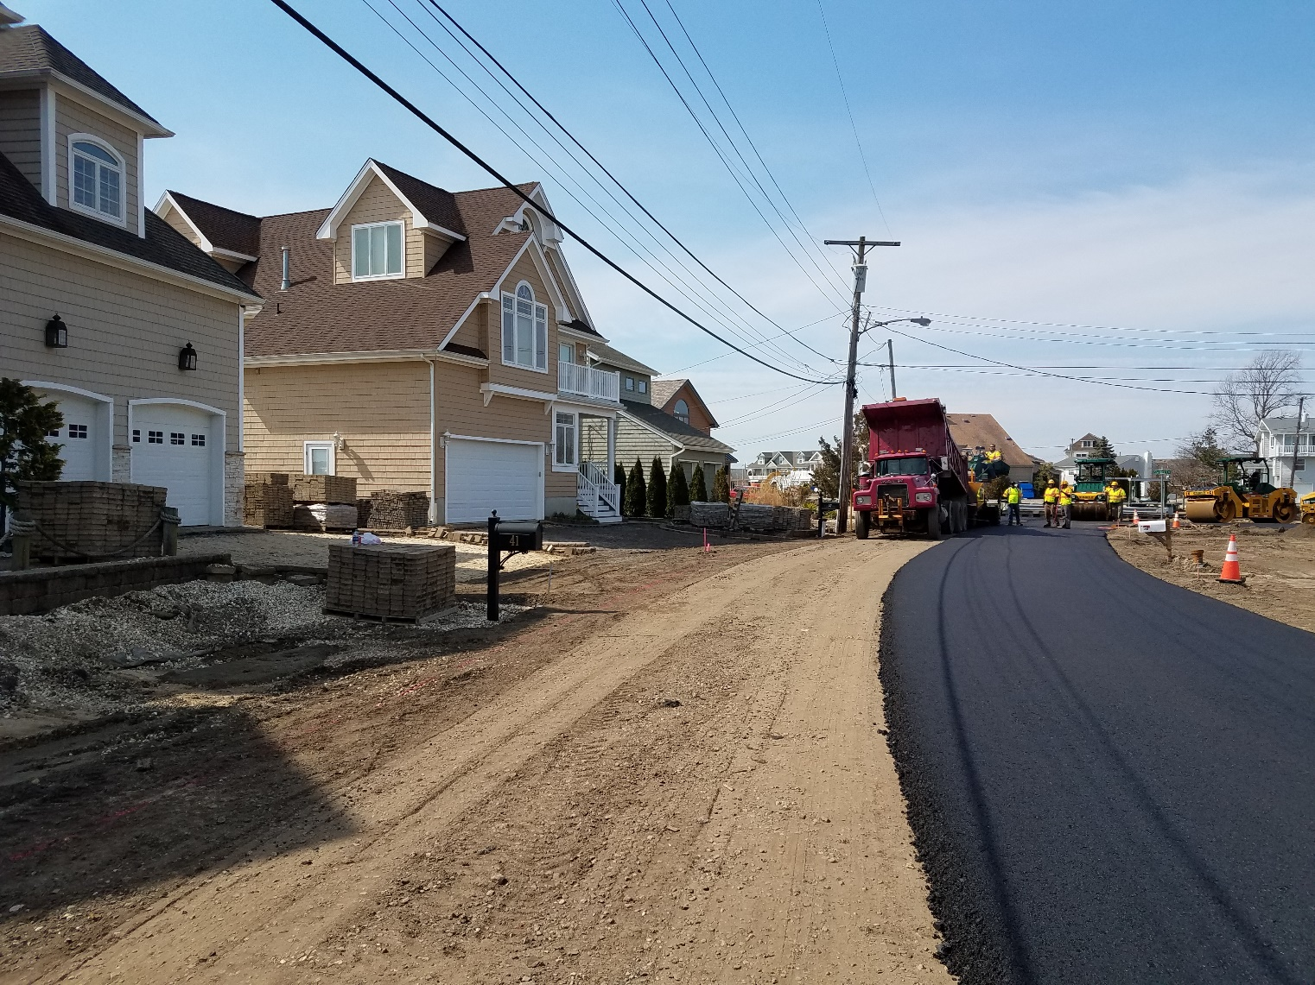
Roadway Elevation Project Presentation
During base paving…
Note how low the mailbox is…..

Slide 21
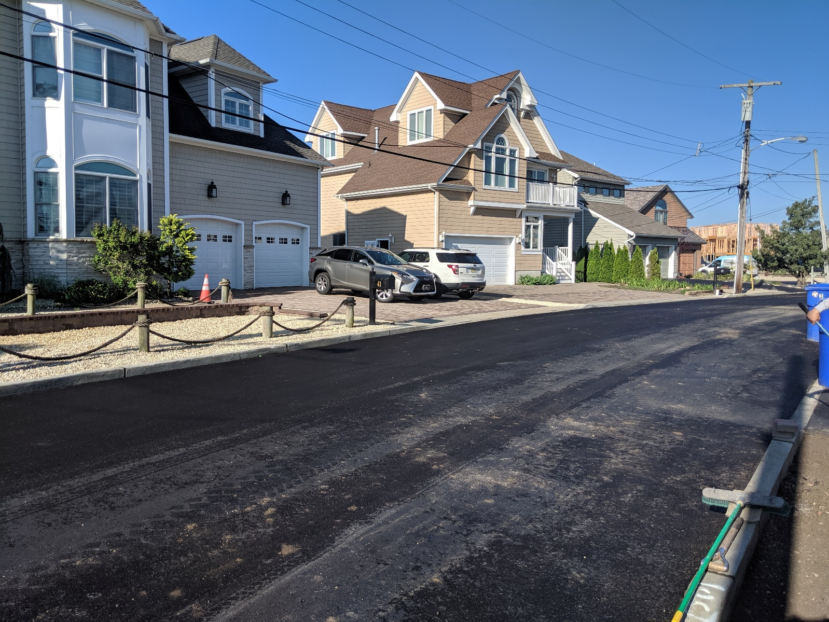
Roadway Elevation Project Presentation
All Done!
Note: Concrete Apron at Paver Driveway

Slide 22
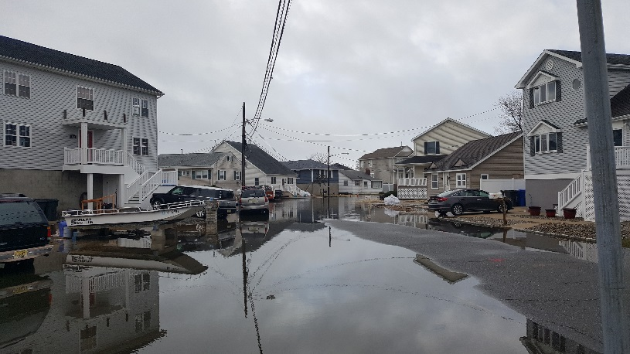
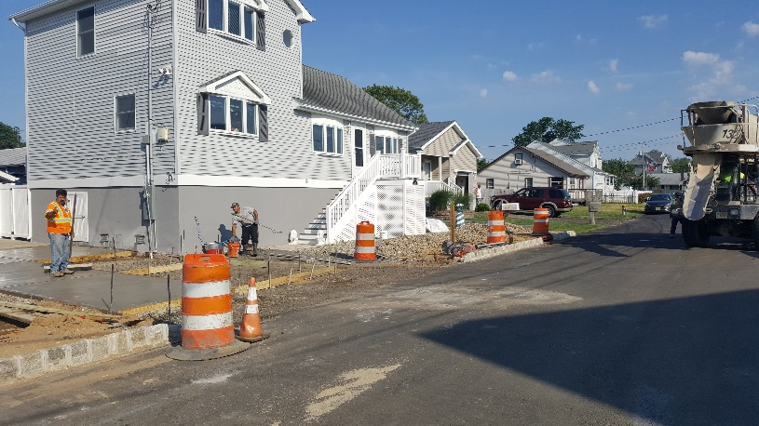
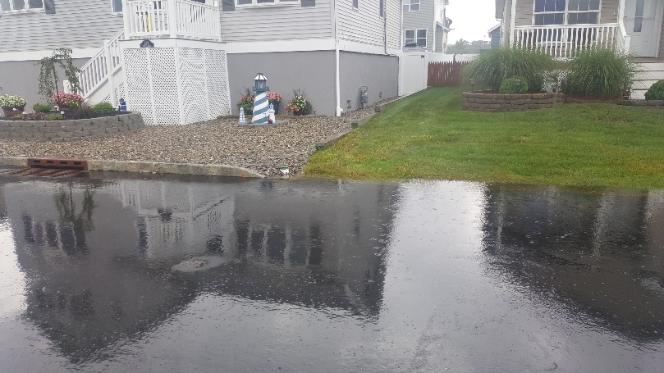
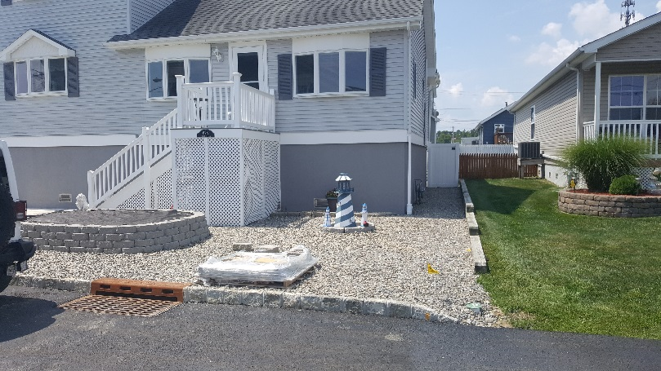
Roadway Elevation Project Presentation
Creek Road after completion….

Slide 23
Roadway Elevation Project Presentation
Common Questions….
There is a misconception that elevating a road will divert water onto private property.
Newly Elevated Road & Driveway
Road
Driveway

Slide 24
Roadway Elevation Project Presentation
Common Questions….
Will my property be restored properly?
The Township will reinstall what we remove or replace it. Some items can be re-set such as pavers, mailboxes, etc.. Most improvements will be new.

Slide 25
Roadway Elevation Project Presentation
Lessons Learned….Right of Entry Letters:
After the plans are finalized, we will send individual right of entry letters & maps to each effected lot owner with a description of what will take place on your lot.
Some residents return the letter within a week; some take six months.
This will delay the project……

Slide 26
Roadway Elevation Project Presentation
Open Discussion & Questions……

Slide 27
Roadway Elevation Project Presentation
Virtual Sign In:
Please Email: engineering@tomsrivertownship.com
Re: Road Elevation

